Slide 1
Displaying text
print

Slide 2
Have you ever used a computer to..
Read a book ?
Read a movie review ?
Read instructions on how to clean crayon off your walls.
Learn all about the capybara?

Slide 3
Many computer programs provide information.
One of the simplest and important thing you need in your code is the ability to display text.

Slide 4
The print statement is used to display text
print(‘Hicory Dickory Dock! The mouse ran up the clock’)
print(“Hicory Dickory Dock! The mouse ran up the clock”)
You can use either single quote or double quotes .

Slide 5
DEMO
Printing text

Slide 6
Multiple lines

Slide 7
Does it matter if you use single or double quotes?
print(‘Hicory Dickory Dock! The mouse ran up the clock’)
print(“Hicory” Dickory Dock! The mouse ran up the clock”)
Only if the string you are displaying contains single or double quote.
It’s a good habit to pick one and stick with it as much as possible.

Slide 8
What if I want my text to appear on multiple lines?
You can use multiple print statements
print(‘Hicory Dickory Dock! ‘)
print(‘ The mouse ran up the clock’)

Slide 9
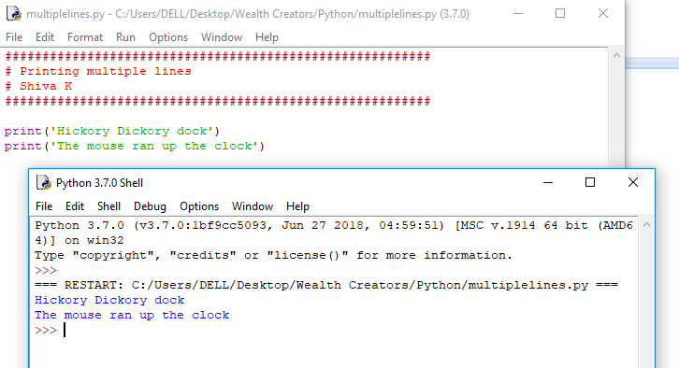

Slide 10
You can also use \n to force a new line.
You can use multiple print statements
print(‘Hicory Dickory Dock!\n The mouse ran up the clock ‘)
print(‘Hicory Dickory Dock!\n The mouse ran up the clock ‘)

Slide 11
Here’s a neat python trick: triple quotes
print(‘‘‘Hicory Dickory Dock! The mouse ran up the clock ’’’)
print(“““Hicory Dickory Dock! The mouse ran up the clock”””)
When you put the string in triple quotes, it will display the string as it is in text editor.

Slide 12
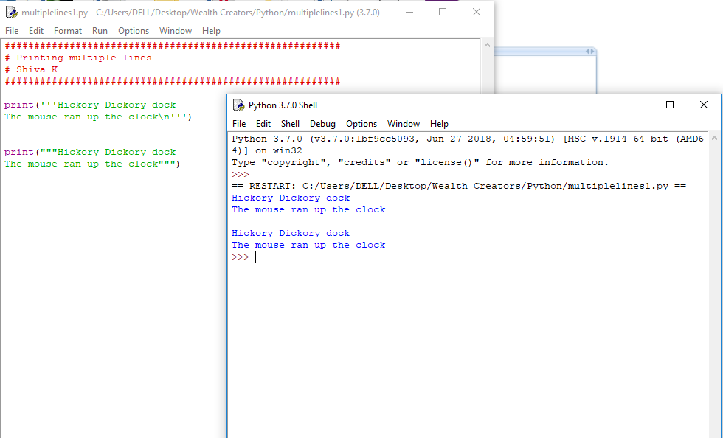

Slide 13
Demo
Line management

Slide 14
Same problem,multiple solutions

Slide 15
Which do you think is the better?
print(‘Hicory Dickory Dock! ‘)
print(‘ The mouse ran up the clock’)
print(“““Hicory Dickory Dock!
The mouse ran up the clock”””)
print(‘Hicory Dickory Dock! \n The mouse ran up the clock ‘)

Slide 16
Geek tip!
There is often more than one way to solve a problem.
Some times, it really doesn’t matter in which you solve the problem

Slide 17
Demo
Multiple options ,same ouput

Slide 18
When good code goes bad...

Slide 19
There is another important programming concept you need to learn as well..
It’s ok to make mistakes in your code.
All programmers make typing mistakes and coding mistakes.

Slide 20
So, it might be useful to finding our own mistakes
print(Hickory Dickory Dock)
print('It's a small world')
print("Hi there')
prnit("Hello World!")

Slide 21
So, it might be useful to finding our own mistakes
print('Hickory Dickory Dock')
print("It's a small world")
print("Hi there")
print("Hello World!")

Slide 22
Your challenge should you choose to accept it
Write a program that will display the following poem on the screen
There once was a movie star icon
who preferred to sleep with the light on.
They learned how to code
a device that sure glowed
and lit up the night using Python!

Slide 23
Congratulations!
Now, you can write a computer program that can share information with a user.

